Slide 1
WAVES
Overview and SOUND!

Slide 2
Types of Waves
Longitudinal
Transverse
http://www.acs.psu.edu/drussell/demos/waves/wavemotion.html

Slide 3
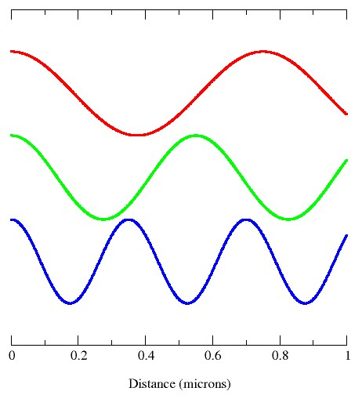
Anatomy of a Wave
Amplitude
Frequency
Wavelength
Pitch

Slide 4
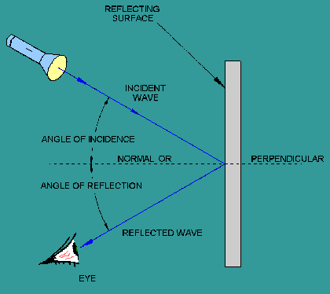
Reflection
When a wave hits a surface and bounces back.
The law of reflection states that the angle of incidence equals the angle of reflection.
With sound this is an echo.

Slide 5
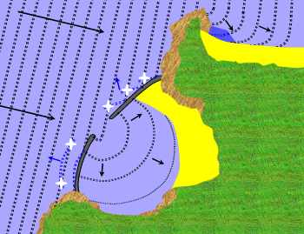
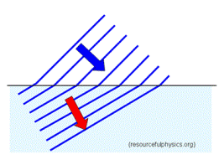
Refraction/Diffraction
When a wave enters a new medium at an angle, one side of the wave changes speed before the other side, causing the wave to bend.
Diffraction is when a wave moves around a barrier or through an opening in the barrier….it bends and spreads out. Sound waves can do this too!

Slide 6
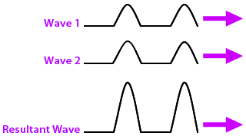
Constructive Interference
Two or more waves combine to make a larger wave.
Sound waves can interfere with one another in a good way and bad!

Slide 7
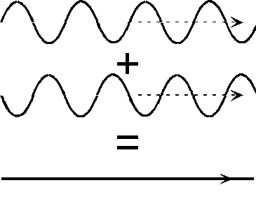
Destructive Interference
Two or more waves combine and the result is a smaller amplitude.

Slide 9
Sound Waves moving
The speed of sound depends on the elasticity, density, and temperature of the medium through which it travels.
Sound moves faster in warm air than in cold air.
Loudness= amount of energy!

Slide 10
More on Sound!
Pitch of sound has to do with the frequency of the wave. A high frequency has a high pitch, and a low frequency has a low pitch.
Doppler effect:
http://videos.howstuffworks.com/discovery/27963-assignment-discovery-doppler-effect-video.htm

Slide 11
Echolocation

Slide 12
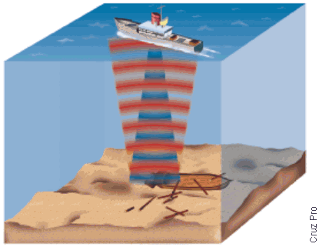
Sonar: Sound Navigation and ranging

