Slide 1
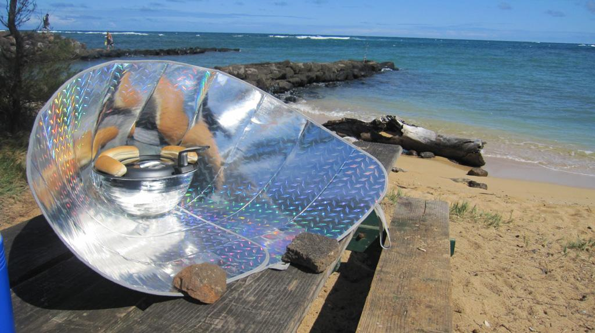
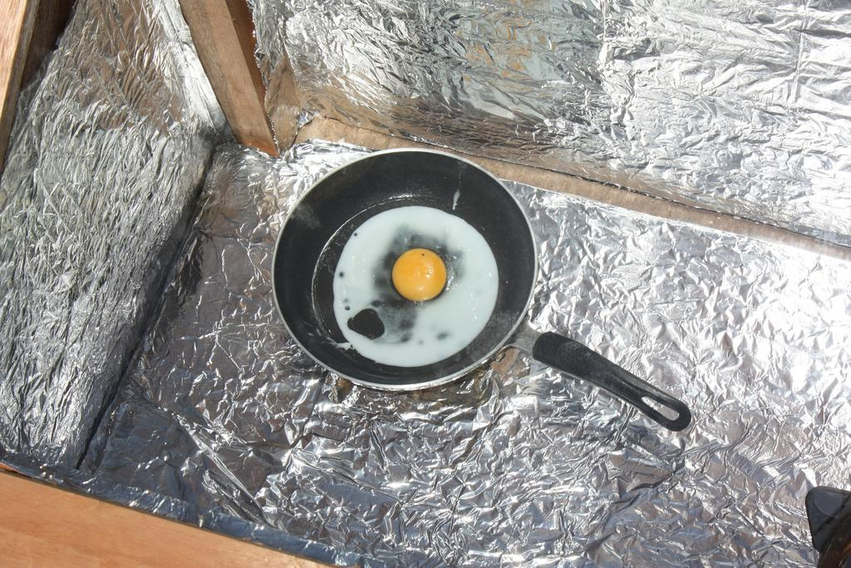
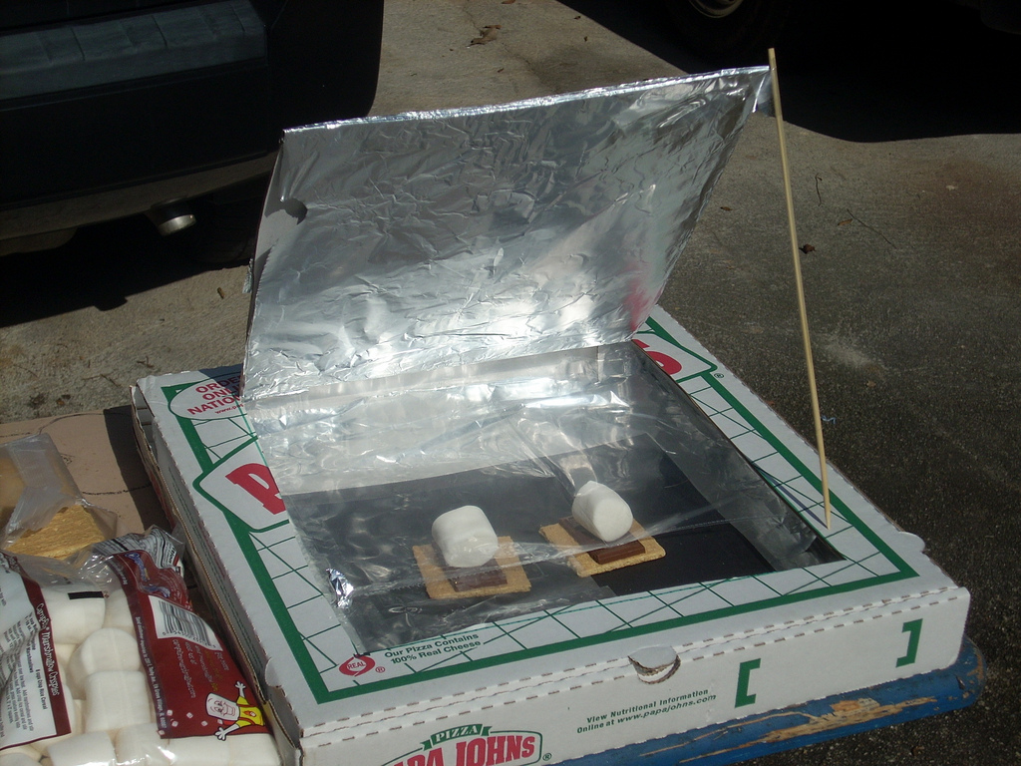
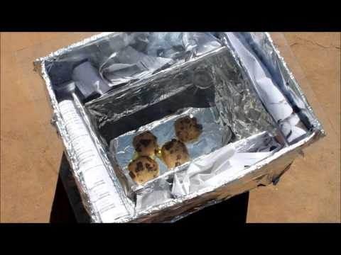
Solar Oven Cook-Off!
Final Project

Slide 2
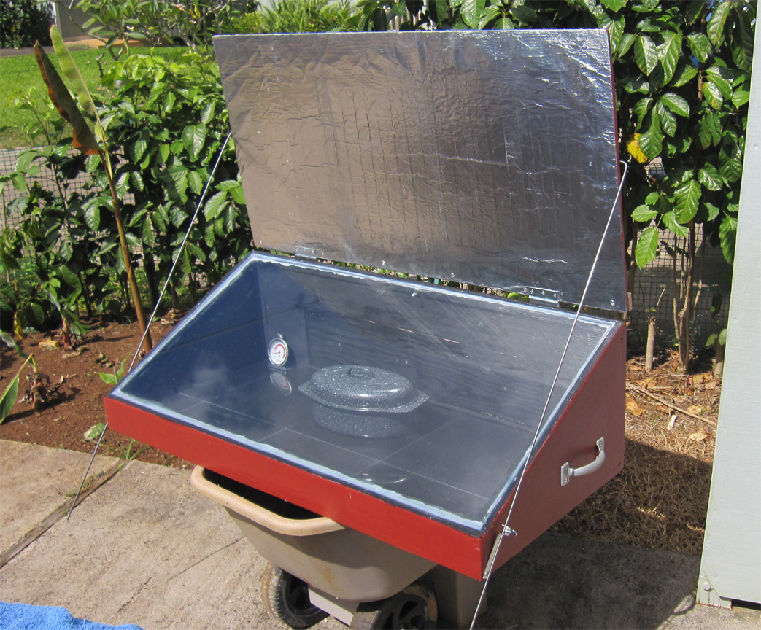
Goals
Statement of the Problem: Apply scientific principles to design, construct, and test a solar oven that maximizes thermal energy transfer.
In teams of two or three you will research, design and participate in a solar oven cook-off.
Required Outcomes: Report and Blueprints, Oven, Recipe and Data Collection
Do Not Spend over $10 for supplies.
HOW?!
Notes:
Brainstorm with students what steps/process they will have to go through in order to build successful solar ovens.

Slide 3
Research
1. What type of solar cooker (panel, parabolic, or box) will your group construct?
2. What will you cook to display functionality of your solar oven?
3. What are two reasons for your choice?
* These should be answered in the problem section of your papers.
Notes:
I will walk around and conference with groups during each class period. After the third day of research I will check their google documents to make sure that the title problem and hypothesis is done. If needed I will provide feedback.

Slide 4
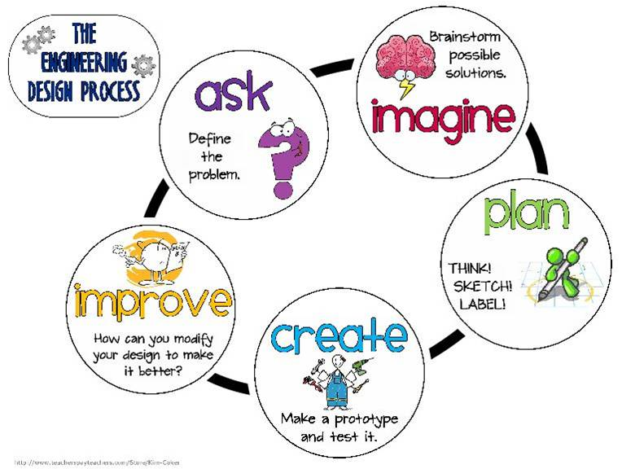
How?! *All parts should be typed up in your google doc and submitted as completed.
Research (HW prior to class, submit plans for approval before designing)
Recipe/Cooking materials and Procedure (HW research and procedure)
Design (1-2 classes, draw detailed blueprints, including all measurements, submit for approval)
Build (2 classes, follow all lab safety procedures, be mindful of waste)
Test (1 class, conduct test to determine if cooker is working properly)
Redesign (1 class, make any changes necessary to improve cooker)
Cook!! (This will be done at the same time on a designated day)
Notes:
At the end of each section I will check their google doc and provide feedback for that portion of the project. If time allows we will have students provide feedback on the blueprints.

Slide 5
Recipe/Cooking Materials and Procedure
Type out in your google doc what you plan to cook and how.
This should be based on your research.
These sections are fluid and can changed based on designs and needs.

Slide 6
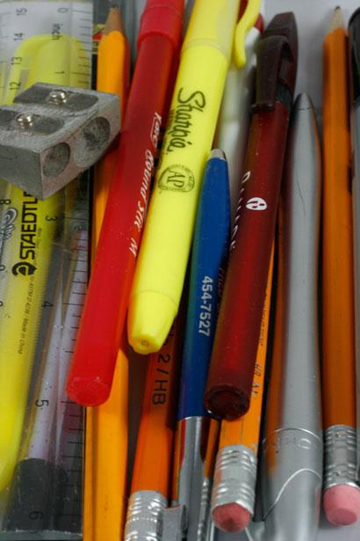
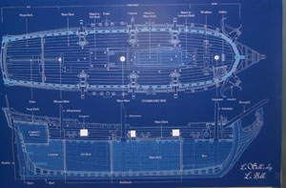
Design
Draw detailed blueprints
Include all materials
Use accurate measurements
Describe different types of materials used in the design solution, their properties and how these materials will be used to maximize thermal energy transfer. (e.g., thickness, heat conductivity, reflectivity)
*Copy of blueprint and list of materials should be added to your report.
Notes:
I will walk around and conference with groups during each class period. The design blueprint is being turned into me after the 5th day of the project, I will review designs at home and provide feedback and then give more time to make changes based on feedback.

Slide 7
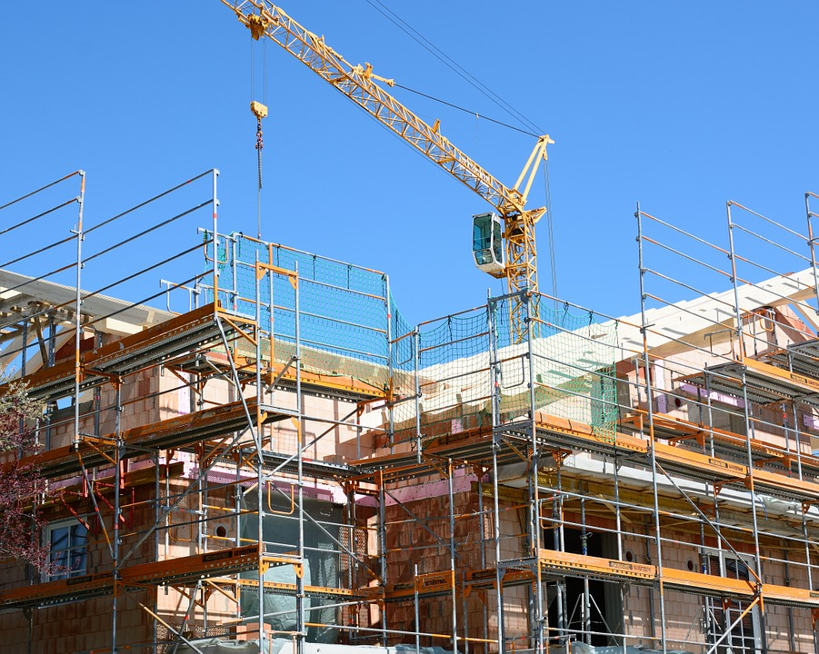
Build
Follow all lab safety procedures
Ask before grabbing materials
Be mindful of waste
Return all lab supplies to where you got them from

Slide 8
Test
Set up solar cooker in a sunny place in the garden.
Determine the time interval you will use for recording data.
Collect all data accurately and graph it.
Take notes to include in the procedure, data, and conclusion sections of your report.
*While testing use any down time to work on your report. I expect them to be detailed well written documents.

Slide 9
Redesign
Using qualitative and quantitative observations from your test make any changes necessary to improve cooker.
*If no changes are necessary make sure all parts are typed up in your report.

Slide 10
Conclusion
Your conclusive summary of this project should:
Adress the original problem. Did your solar oven work to your expectations? Include qualitative and quantitatiive evidence.
EXPLAIN why you accepted or rejected your hypothesis using data from the lab
Make suggestions of any modifications that you would make to improve the functioning of your oven.
4. What questions do you still have regarding thermal energy transfer?

