Slide 1
Cellular Respiration
Making lots of ATP!

Slide 2
Chemical Equation
C₆H₁₂O₆ + 6O₂ → 6CO₂ + 6H₂O + ATP
Notice how similar it is to photosynthesis??
Yep! Pretty much the same equation, just backwards!
Notice that oxygen is needed for this process…that means it is aerobic.

Slide 3
Oxygen…or no oxygen
Aerobic = needs oxygen
Anaerobic = does not need oxygen
Cellular respiration is considered an aerobic process.
Glycolysis and fermentation are anaerobic processes!

Slide 4
First things first
Remember that glucose made during photosynthesis….
Well, first that glucose has to be split into two smaller molecules called pyruvate.
That process is called glycolysis and takes place in the cytoplasm outside the mitochondria.
Glycolysis provides a net gain of 2 ATP!

Slide 5
More on Glycolysis
As you can see, two ATP are used to phosphorylate the glucose, which makes it more reactive, and the glucose splits into two molecules.
Then, an enzyme adds two more phosphate groups onto the two three-carbon sugars while NAD⁺ is converted to NADH, and then, in a series of reactions, 4 ATP are made while the sugars are converted to pyruvate.
Glycolysis does not use oxygen…therefore it is anaerobic!

Slide 6
Part 1 of Cellular Respiration: Krebs Cycle
AKA: Citric Acid Cycle and takes place in the matrix (kind of like the cytoplasm of the mitochondria)
Step 1: pyruvate is broken down into CO₂ and a two-carbon molecule. CO₂ is released from the mitochondria. NAD⁺ → NADH
Step 2: coenzyme A bonds to the two-carbon molecule that was just made. This enters the Krebs cycle.

Slide 7
Krebs cycle continued
Step 3: the two-carbon molecule is transferred from the coenzyme A to a four-carbon molecule to make citric acid (hence the citric acid cycle) Coenzyme A goes back to step 2
Step 4: CO₂ is broken off of the citric acid, NADH is formed, and the 5-carbon molecule moves on.
Step 5: CO₂ is broken off of the citric acid, NADH is formed, and the 4-carbon molecule moves on.
Step 6: The 4-carbon molecule is re-arranged so that it is again used in step 2 to make more citric acid! NADH and FADH are formed.

Slide 8
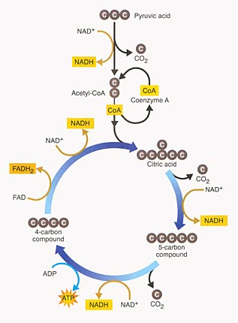
Gotta love pictures!

Slide 9
Summary of Kreb’s Cycle
For each glucose, we go through two turns of the Kreb’s cycle.
3 molecules of CO₂ are released in each turn
1 molecule of ATP is made in each turn
4 molecules of NADH go to the ETC
1 molecule of FADH₂ goes to the ETC

Slide 10
Part 2 of cellular respiration: ETC
Electron Transport Chain!
This happens in the inner membrane of the mitochondria.
This is where the majority of ATP are produced
Step 1: Hydrogens are stripped from NADH and FADH_{2,} which means that H⁺ ions and electrons are released.

Slide 11
ETC continued
Step 2: H⁺ are transported across the inner membrane, against the concentration gradient as the electrons move down the electron transport chain.
Step 3: The H⁺ flow back through a protein channel and while they do this ADP is converted to ATP (ATP synthase)
Step 4: Oxygen is split and combines with two H⁺ and two electrons to make water, which is released as a waste product.

Slide 12
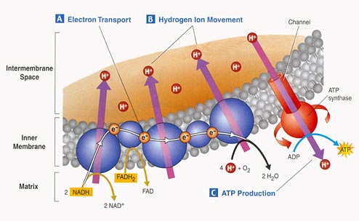
More pictures!

