Slide 1
Photosynthesis
6CO₂ + 6H₂O + light energy → C₆H₁₂O₆ + 6O₂

Slide 2
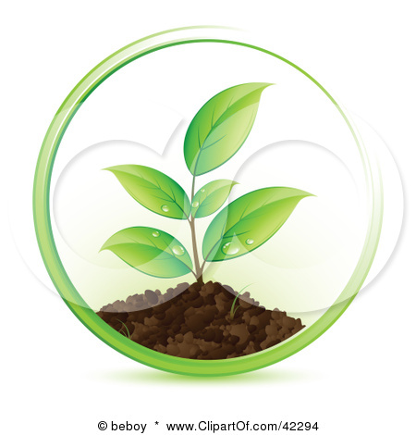
Photoautotrophs… these are the guys that do photosynthesis
Photo = light
Auto = self
Troph = feed
Photoautotrophs = plants (they use light to feed themselves)

Slide 3
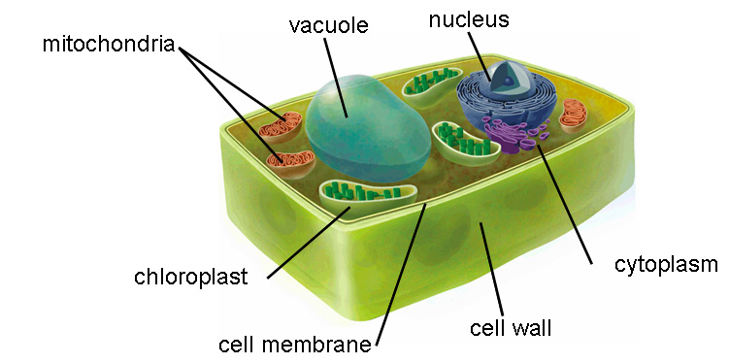
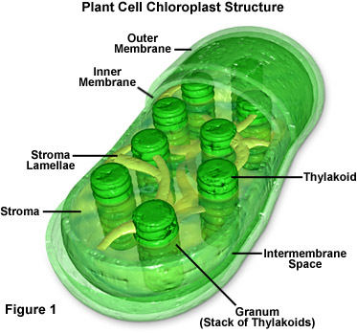
Where photosynthesis takes place…
Inside the plant cell..
In the chloroplasts
Anywhere the plant is green, there are chloroplasts, however, the majority of photosynthesis happens in the leaves.

Slide 4
Overview of photosynthesis
2 parts: light reactions and Calvin cycle
Chlorophyll: molecule inside chloroplasts that absorb the light energy
Photosynthesis is a reduction reaction (gain of electrons or hydrogen)

Slide 5
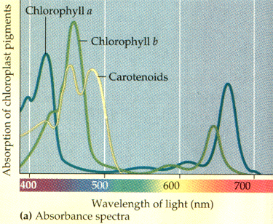
Chlorophyll
Chlorophyll a
Chlorophyll b
Appears blue-green in color
Participates directly in the photosynthesis reactions because it is located in the reaction center
Appears yellow-green in color
Can transfer energy to chlorophyll a

Slide 6
How does chlorophyll work?
When a chlorophyll a molecule absorbs a photon (light energy) one of the molecule’s electrons moves to a higher orbital.
That electron is transferred to the primary electron acceptor.
And that is step 1 of photosynthesis ☺

Slide 7
Anatomy of Chloroplast

Slide 8
The light reactions
Step 1: electron goes to primary electron acceptor
Step 2: enzyme breaks water, oxygen is released and the hydrogen ions are used to replace the electron on the chlorophyll that was lost in step 1
Step 3: electrons go from one protein to another in a chain called an electron transport chain…hydrogen ions are pumped across the thylakoid membrane (against the concentration gradient)

Slide 9
The light reactions continued…
Step 4: ATP is made from the electrons falling down the chain (specifically a phosphate group is attached to ADP) This ATP will be used in the Calvin Cycle
Step 5: the electrons reach the bottom of the electron transport chain and fills a “hole” in the chlorophyll a in the reaction center of photosystem I
Step 6: the electrons pass from the primary electron acceptor of photosystem I to an iron containing protein which then transfers the electrons to NADP⁺ to make NADPH (used to make sugar in Calvin cycle)

Slide 10
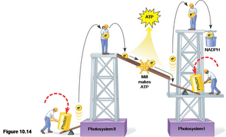
Light reactions..picture form

Slide 11
The Calvin cycle
Step 1 (Carbon fixation): Carbon dioxide is attached to ribulose biphosphate (RuBP, a 5 carbon sugar) by an enzyme called rubisco (most abundant protein on Earth). The molecule formed is very reactive and immediately splits into two molecules of 3-phosphoglycerate.
Step 2 (reduction): A phosphate from ATP is transferred to each 3-phosphoglycerate forming 1,3-biphosphoglycerate. Then NADPH donates a pair of electrons to the molecule, making glyceraldehyde 3-phosphate (one of the phosphates is removed). One G3P is released from the cycle, the others move on to the next phase.

Slide 12
Calvin cycle continued…
Phase 3 (regeneration of carbon dioxide acceptor, RuBP): 3 molecules of ATP and 5 molecules of G3P are rearranged to make three molecules of RuBP
This cycle has to happen three times to make one glucose molecule.
To make 1 molecule of G3P (two of these are combined to make glucose) it takes 9 ATP and 6 NADPH molecules. (from the light reactions)
The Calvin cycle takes place in the stroma of the chloroplast.

