Slide 1
Electricity

Slide 2
Electric charge:
Similar to the charges of magnets.
Charges that are the same repel each other, and charges that are different attract each other.

Slide 3
We have learned that magnetic force is the attraction or repulsion between magnetic poles.
In electricity, electric force is the attraction or repulsion between electric charges.

Slide 4
Recall that magnetic fields extend around a magnet.
Similarly, in an electric field extends around a charged object.
An electric field is a region around a charged object where the object’s electric force is exerted on other charged objects.

Slide 5
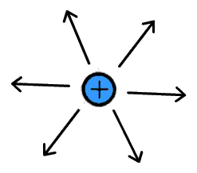
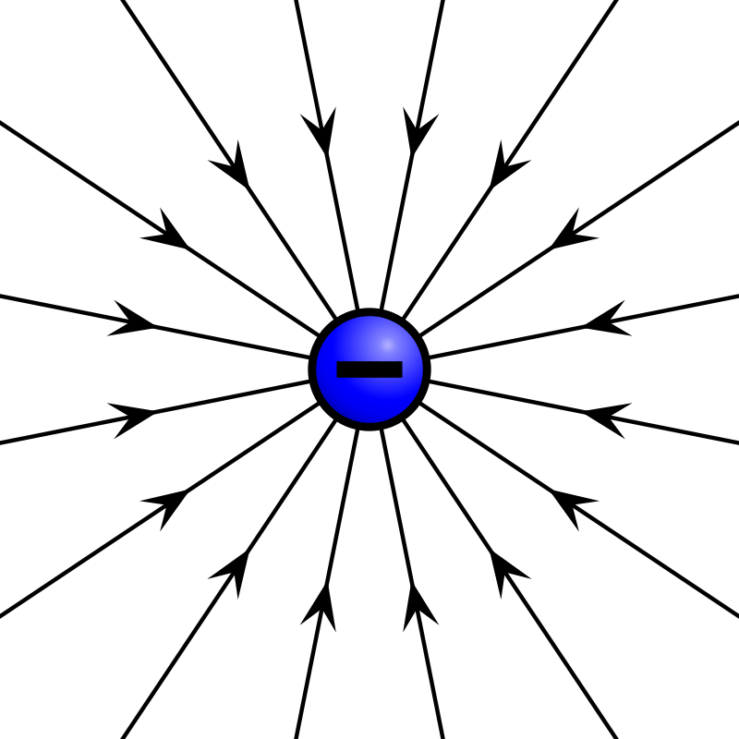
The stronger the field, the closer the lines are together. + points outward - points inward

Slide 6
The buildup of charges on an object is called static electricity.
Static means “not moving or changing”.
In static electricity, charges build up on an object, but they do not flow continuously.
Balloon and your hair
More electrons move to the balloon from your hair

Slide 7
An object becomes charged only when electrons are transferred from one location to another.

Slide 8
Charges are neither created nor destroyed. This is known as the law of conservations of charge.

Slide 9
There are 3 methods by which charges can be transferred to build up static electricity:
Changing friction
Conduction
Induction

Slide 10
Friction:
The transfer of electrons from one uncharged object to another by rubbing.
Electrons are rubbed from the carpet to a girl’s sock. They are distributed evenly over the sock.

Slide 11
Conduction:
The transfer of electrons from a charged object to another object by direct contact.
When the negatively charged sock touches the skin, electrons are transferred by direct contact. Electrons are distributed throughout the girl’s body.

Slide 12
Induction:
The movement of electrons to one part of an object that is caused by the electric field of a second object.
Electron’s on the girl’s finger tip produce an electric field that repels negative charges and attracts positive charges on a doorknob. An overall positive charge is induced on the edge of the doorknob.

Slide 13
Charges that build up as static electricity on an object don’t stay forever. They tend to move, returning the object to its neutral condition.

Slide 14
When a negatively charged object and a positively charged object are brought together, electrons transfer until both have the same charge.
The loss of static electricity as electric charges transfer from one object to another is called static discharge.
Produces a spark.

Slide 15
Lightening is a dramatic example of static discharge.
You can think of lightning as a huge spark. During thunderstorms, air swirls violently and water droplets within the clouds become electrically charged. To restore a neutral condition in the clouds, electrons move from areas of negative charge to areas of positive charge and produce an intense spark. This is what we see as lightning.

Slide 16
Electric Current
An electric current is the continuous flow of electric charges through a material.
The amount of charge that passes through the wire in a unit of time is the rate of electric current. The name of this unit is called the amp.

Slide 17
A conductor transfers electric charge well, and an insulator does not transfer electric charge well.
Conductor:
Metals
Insulator:
Rubber, glass, sand, plastic, and wool.

Slide 18
Potential energy is the energy an object has as a result of its position, or height.
The higher a roller coaster cart goes up, the more potential energy it will gain.
In circuits, potential energy is not related to height. Instead, it is related to the charges inside the battery.

Slide 19
The difference in electrical potential energy between two places in a circuit is called voltage.
The unit of measure of voltage is the volt (V).
The voltage source is a device that creates potential difference in an electric circuit.
Batteries
Generators

Slide 20
Resistance is the measure of how difficult it is for charges to flow through a material.
The greater the resistance, the less current there is for a given voltage.

Slide 21
There are 4 ways to determine the resistance of a wire:
What the material is made of
Insulators
Length
Long wires have more than short
Diameter
Smaller diameter has less water flowing through a pipe than the one with the larger diameter
Temperature of the wire
Resistance increases as temperature increases.

Slide 22
Electric Circuits
The relationship between resistance, voltage, and current is summed up on Ohm’s law.
Ohm’s law says that the resistance is equal to the voltage divided by the current.

Slide 23
Resistance= Voltage ÷ Current

Slide 24
Features of a circuit:
Circuits have devices that are run by electrical energy.
A circuit has a source of electrical energy.
Electric circuits are connected by conducting wires.

Slide 25
Circuit Symbols
Wire
Switch
Energy source
Resistor

Slide 26
Series circuit:
There is only one path for the circuit to take.

Slide 27
One path:
Advantage:
Easy to build.
Has some disadvantages:
What happens if a light bulb in a series circuit burns out?
Examples of this?

Slide 28
Resistors:
Disadvantages:
The light bulbs in the circuit become dimmer as more bulbs are added.
Why would this happen?

Slide 29
Parallel circuit:
The different parts of the circuit are on separate branches.
There are several paths for the current to take.
As you gaze at a string of lights, you observe that some bulbs burn brightly, but others are not burned out.

Slide 30
Several paths:
If there is a break in one branch, charges can still move through others.

Slide 31
Resistors:
Overall resistance decreases.
As new branches are added to a parallel circuit, the electric current has more paths to follow, so the overall resistance decreases.

Slide 32
Would you want the circuits in your home to be series circuits or parallel circuits?
WHY?

