Slide 1
Cellular energy!
ATP

Slide 2
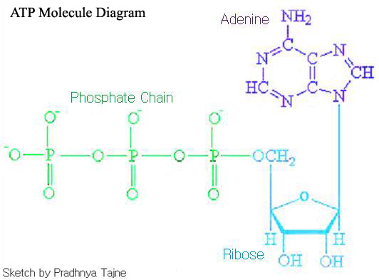
What is ATP?
ATP = adenosine triphosphate
ADP = adenosine diphosphate
Prefix tri = three
Prefix di = two

Slide 3
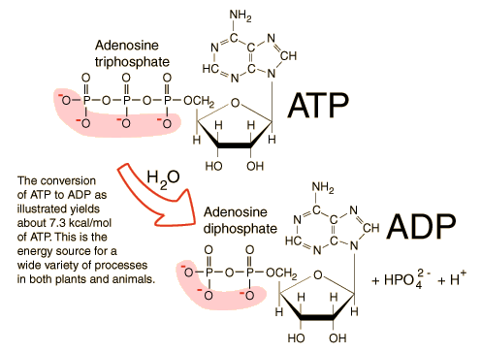
Why is ATP cellular energy?
Remember, chemical bonds have a LOT of energy in them…
When the bond is broken between the second and third phosphates it releases energy
The bond between the second and third phosphate is relatively weak
So, when ATP loses a phosphate molecule, it releases a bunch of energy (well, 7.3 kcal)

Slide 4
How do cells use ATP as energy?
Enzymes shift a phosphate group from ATP to another molecule.
That new molecule is said to be phosphorylated.
That molecule can now do work in the cell.

Slide 5
ADP and ATP recycling…
More than 2 x 10²⁶ molecules or >160kg of ATP is formed in the human body daily!
A working muscle cell recycles ATP at the rate of about 10 million molecules per second.
Can you imagine if your body had to make all of that from scratch each time??

Slide 6
How do we get the ATP back from the ADP?
First we eat!
Then, that food is broken down in the digestive system.
The simple molecules are transported to the cells
Remember those mitochondria??
They take the glucose and use it’s energy to add the phosphate back onto ADP to make ATP

Slide 7
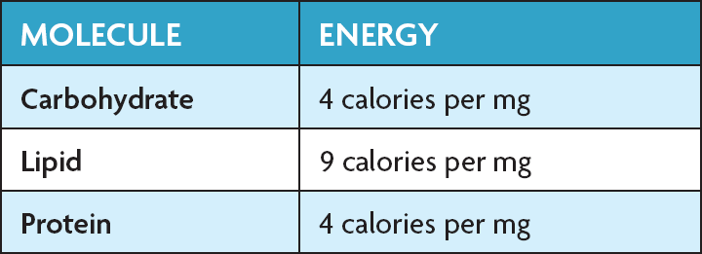
Food to ATP
1 glucose (carbohydrates)molecule can make 36 ATP
1 triglyceride (lipids) can make 146 ATP
Your body stores energy as fat, because it is so much more energy efficient

